Slide 1
Message Digestion Algorithms
A message digest algorithm or a hash function, is a procedure that maps input data of an arbitrary length to an output of fixed length.
The length of output hashes is generally less than its corresponding input message length.
Unlike other cryptographic algorithms, hash functions do not have keys.

Slide 2
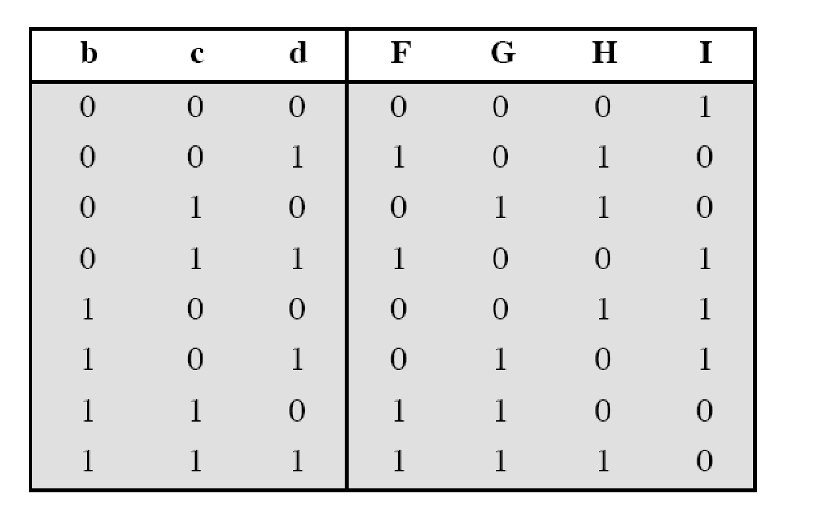
Merkle-Damgard Scheme
Well-known method to build cryptographic hash function
A message of arbitrary length is broken into blocks
length depends on the compression function f
padding the size of the message into a multiple of the block size.
sequentially process blocks , taking as input the result of the hash so far and the current message block, with the final fixed length output
Notes:
Damgard and Merkle greatly influenced cryptographic hash function design by defining a hash function in terms of what is called a compression function.
A compression function takes a fixed-length input and returns a shorter, fixed-length output.
Given a compression function, a hash function can be defined by repeated applications of the compression function until the entire message has been processed.
Take a long message, break it into blocks
M₁, M₂, M₃…M_{k} (pad out last block)
Let f be a “compression function” that operates on a block and the current h-bit state and “mixes” the block into the state
Last output of compression function is the h-bit message digest.
2

Slide 3
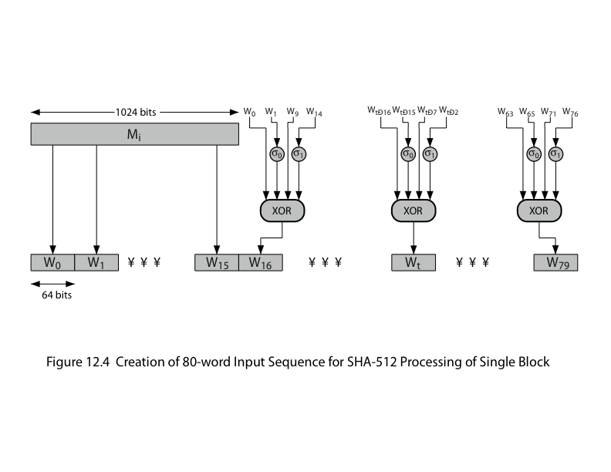
MD5 Message Digest

Slide 4
MD5 Algorithm
The following five steps are performed to compute the message digest of the message.
Step 1. Append Padding Bits
Step 2. Append Length
Step 3. Initialize MD Buffer
Step 4. Process Message in 16-Word Blocks
Step 5. Output

Slide 5
MD5 Overview
2. Append length (64bits)
1. Append padding bits
(to 448 mod 512)
3. Initialize MD buffer (4x32 bits Word)
Word A = 01 23 45 67
Word B = 89 AB CD EF
Word C = FE DC BA 98
Word D = 76 54 32 10
Notes:
5

Slide 6
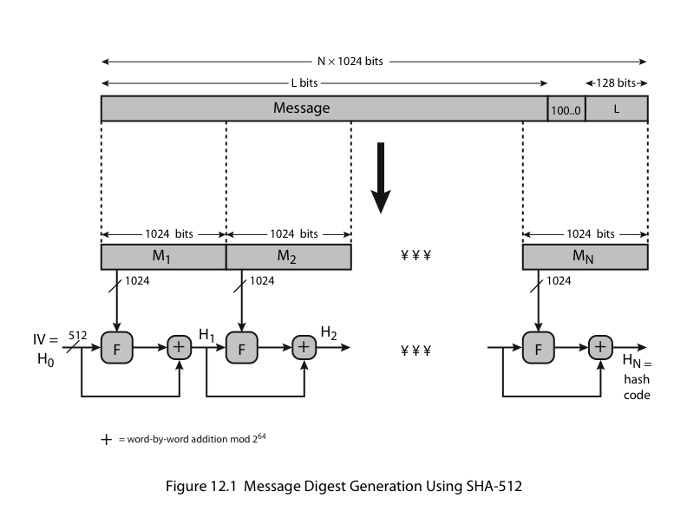
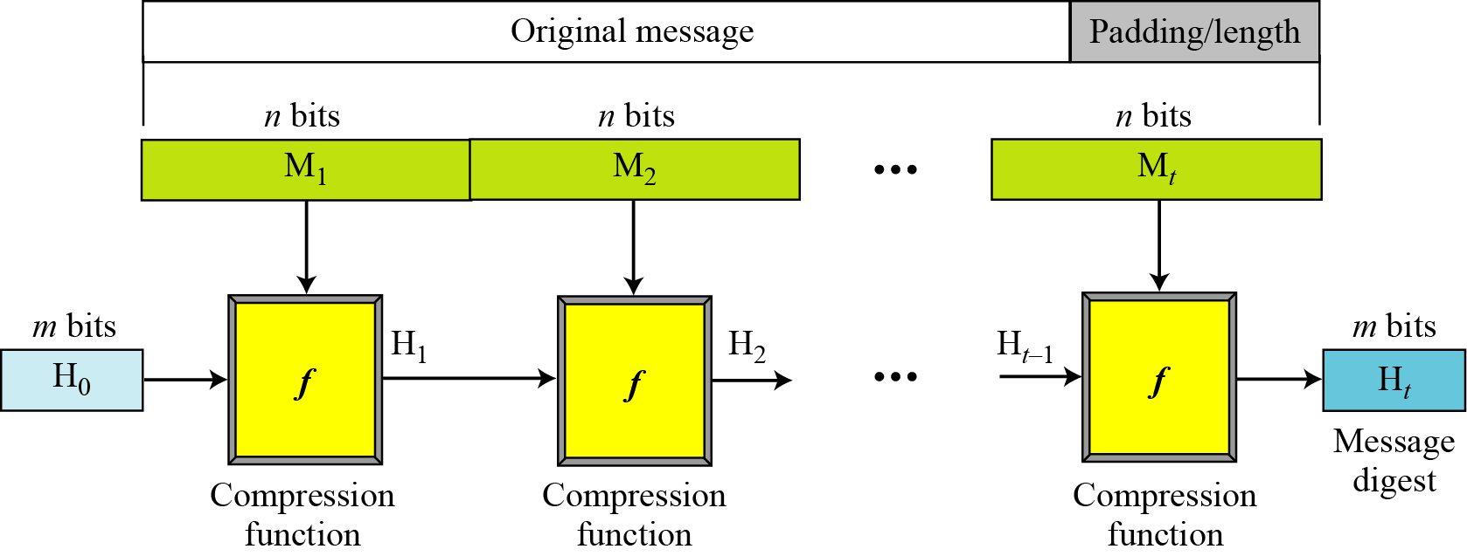
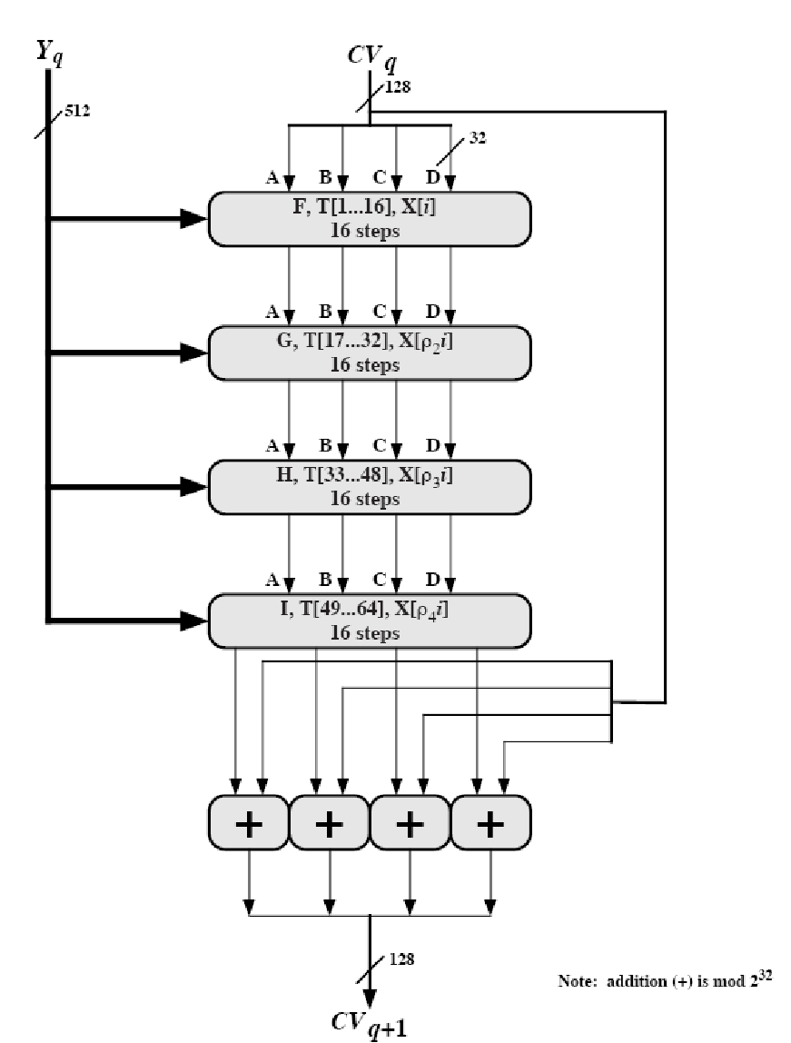
Hash Algorithm Design – MD5
16 steps
X[k] = M [q*16+k] (32 bit)
Constructed from sine function
Notes:
6

Slide 7
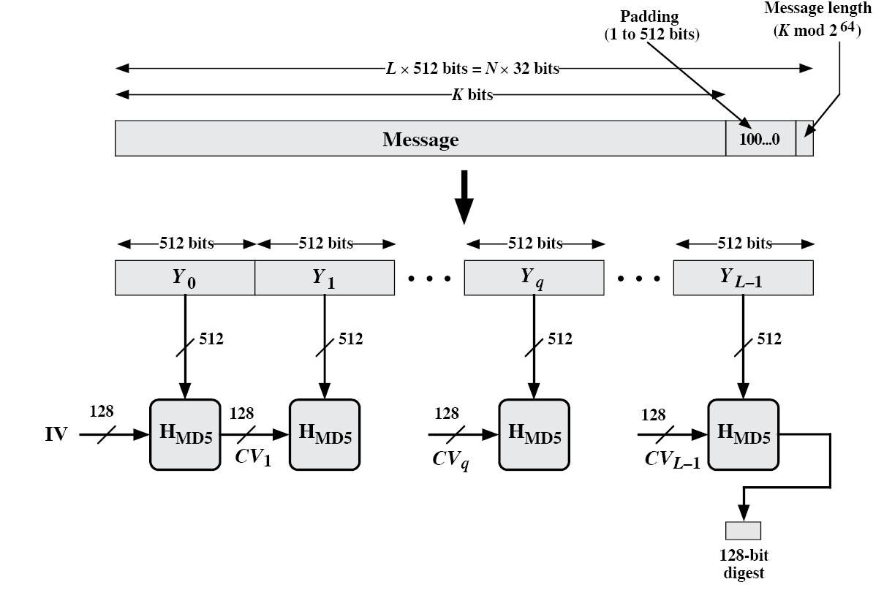
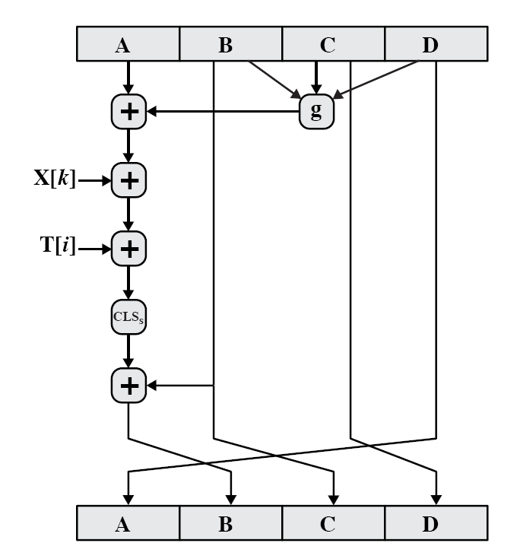
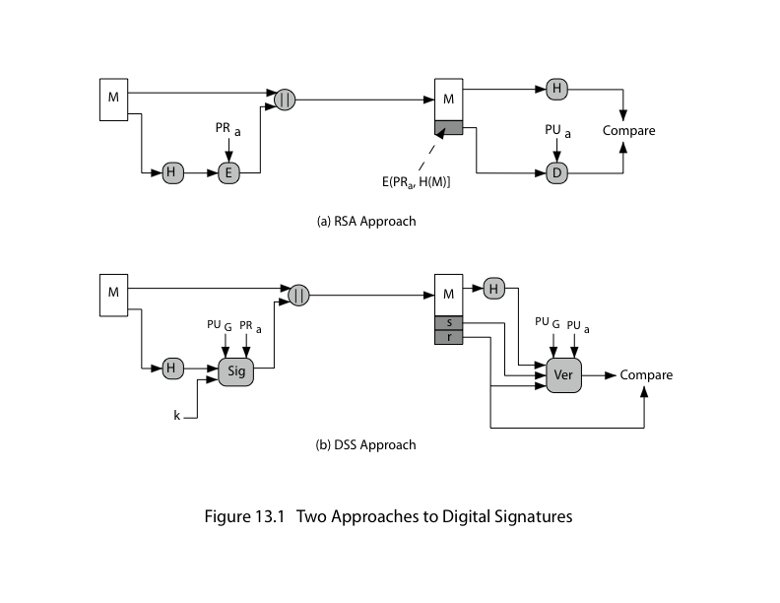
The ith 32-bit word in matrix T, constructed from the sine function
M [q*16+k] = the kth 32-bit word from the qth 512-bit block of the msg
Single step
Notes:
7

Slide 8
Secure Hash Algorithm
SHA originally designed by NIST & NSA in 1993
Was revised in 1995 as SHA-1
US standard for use with DSA signature scheme
Standard is FIPS 180-1 1995, also internet RFC3174
Nb. The algorithm is SHA, the standard is SHS
Based on design of MD4 with key differences
Produces 160-bit hash values
Recent 2005 results on security of SHA-1 have raised concerns on its use in future applications
Notes:
8
The Secure Hash Algorithm (SHA) was developed by the National Institute of Standards and Technology (NIST) and published as a federal information processing standard (FIPS 180) in 1993; a revised version was issued as FIPS 180-1 in 1995 and is generally referred to as SHA-1. The actual standards document is entitled Secure Hash Standard. SHA is based on the hash function MD4 and its design closely models MD4. SHA-1 produces a hash value of 160 bits. In 2005, a research team described an attack in which two separate messages could be found that deliver the same SHA-1 hash using 2^69 operations, far fewer than the 2^80 operations previously thought needed to find a collision with an SHA-1 hash [WANG05]. This result should hasten the transition to newer, longer versions of SHA.

Slide 9
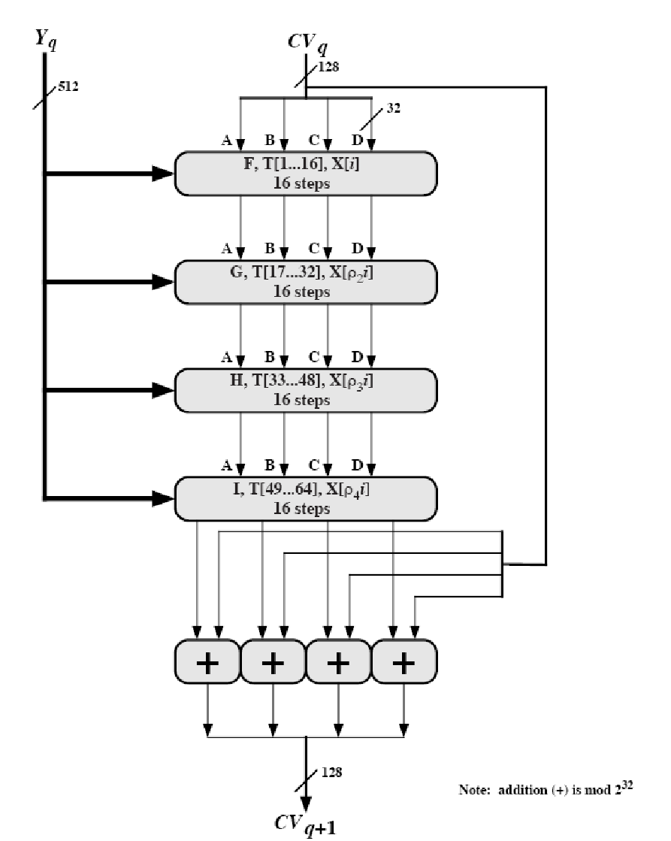
Message digest creation SHA-512
Notes:
9

Slide 10
Revised Secure Hash Standard
NIST issued revision FIPS 180-2 in 2002
Adds 3 additional versions of SHA
SHA-256, SHA-384, SHA-512
Designed for compatibility with increased security provided by the AES cipher
Structure & detail is similar to SHA-1
Hence analysis should be similar
But security levels are rather higher
Notes:
10
In 2002, NIST produced a revised version of the standard, FIPS 180-2, that defined three new versions of SHA, with hash value lengths of 256, 384, and 512 bits, known as SHA-256, SHA-384, and SHA-512. These new versions have the same underlying structure and use the same types of modular arithmetic and logical binary operations as SHA-1, hence analyses should be similar. In 2005, NIST announced the intention to phase out approval of SHA-1 and move to a reliance on the other SHA versions by 2010. See Stallings Table12.1 for comparative details of these algorithms.

Slide 11
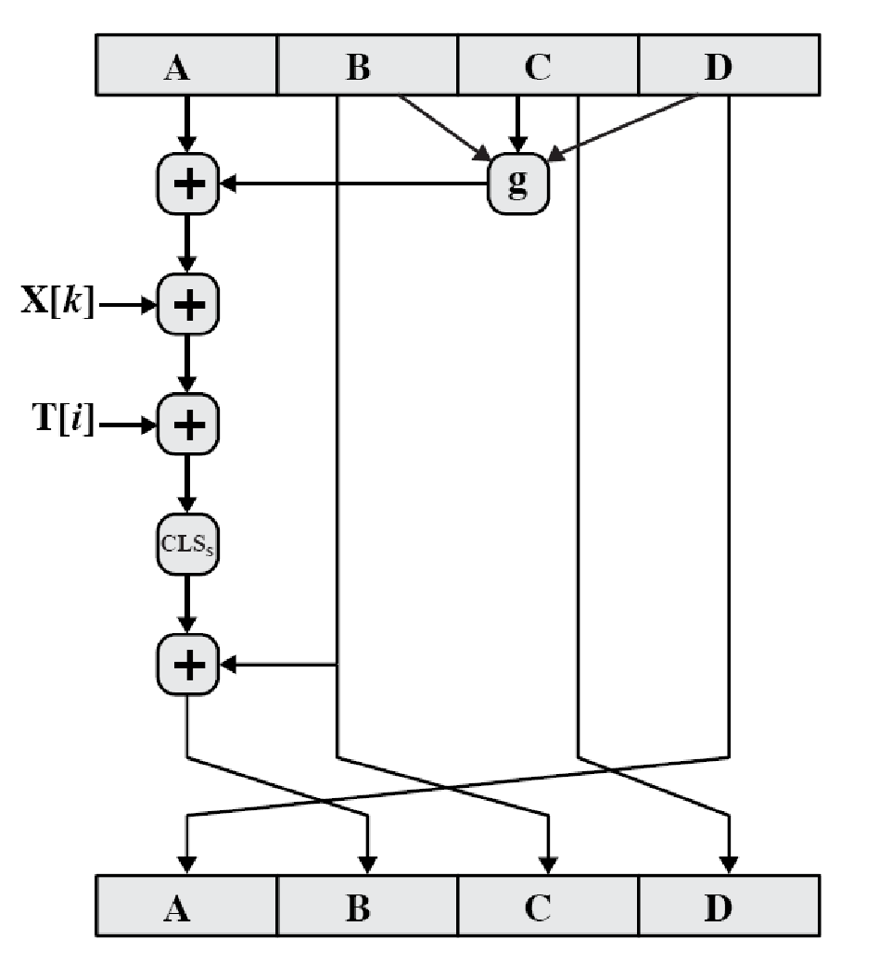
SHA-512 Overview
Notes:
11
Now examine the structure of SHA-512, noting that the other versions are quite similar.
SHA-512 follows the structure depicted in Stallings Figure 12.1. The processing consists of the following steps:
• Step 1: Append padding bits
• Step 2: Append length
• Step 3: Initialize hash buffer
• Step 4: Process the message in 1024-bit (128-word) blocks, which forms the heart of the algorithm
• Step 5: Output the final state value as the resulting hash
See text for details.

Slide 12
SHA-512 Compression Function
Heart of the algorithm
Processing message in 1024-bit blocks
Consists of 80 rounds
Updating a 512-bit buffer
Using a 64-bit value W_{t} derived from the current message block
And a round constant based on cube root of first 80 prime numbers
Notes:
12
The SHA-512 Compression Function is the heart of the algorithm. In this Step 4, it processes the message in 1024-bit (128-word) blocks, using a module that consists of 80 rounds, labeled F in Stallings Figure 12, as shown in Figure 12.2. Each round takes as input the 512-bit buffer value, and updates the contents of the buffer. Each round t makes use of a 64-bit value Wt derived using a message schedule from the current 1024-bit block being processed. Each round also makes use of an additive constant Kt, based on the fractional parts of the cube roots of the first eighty prime numbers. The output of the eightieth round is added to the input to the first round to produce the final hash value for this message block, which forms the input to the next iteration of this compression function, as shown on the previous slide.

Slide 13
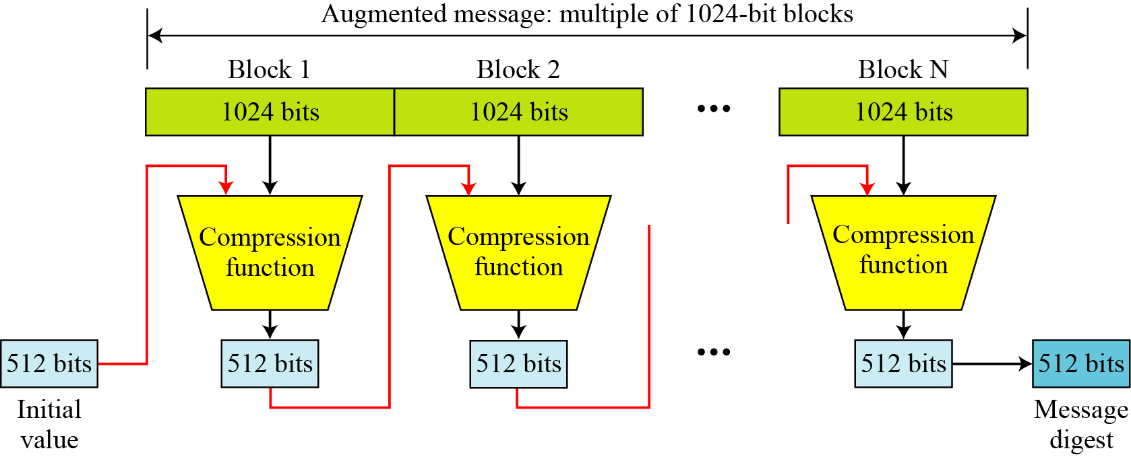
SHA-512 Round Function
Ch(e,f,g) = (e AND f) XOR (NOT e AND g)
Maj(a,b,c) = (a AND b) XOR (a AND c) XOR (b AND c)
∑(a) = ROTR(a,28) XOR ROTR(a,34) XOR ROTR(a,39)
∑(e) = ROTR(e,14) XOR ROTR(e,18) XOR ROTR(e,41)
+ = addition modulo 2^64
K_{t} = a 64-bit additive constant
W_{t} = a 64-bit word derived from the current 512-bit input block.
Notes:
13
The structure of each of the 80 rounds is shown in Stallings Figure 12.3. Each 64-bit word shuffled along one place, and in some cases manipulated using a series of simple logical functions (ANDs, NOTs, ORs, XORs, ROTates), in order to provide the avalanche & completeness properties of the hash function. The elements are:
Ch(e,f,g) = (e AND f) XOR (NOT e AND g)
Maj(a,b,c) = (a AND b) XOR (a AND c) XOR (b AND c)
∑(a) = ROTR(a,28) XOR ROTR(a,34) XOR ROTR(a,39)
∑(e) = ROTR(e,14) XOR ROTR(e,18) XOR ROTR(e,41)
+ = addition modulo 2^64
Kt = a 64-bit additive constant
Wt = a 64-bit word derived from the current 512-bit input block.

Slide 14
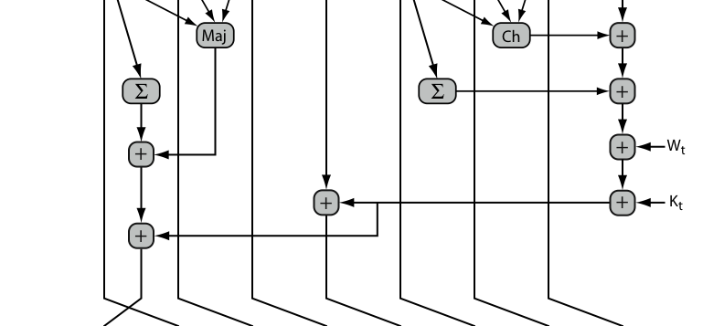
SHA-512 Round Function
σ₀(x) = ROTR(x,1) XOR ROTR(x,8) XOR SHR(x,7)
σ₁(x) = ROTR(x,19) XOR ROTR(x,61) XOR SHR(x,6).
Notes:
14
Stallings Figure 12.4 details how the 64-bit word values Wt are derived from the 1024-bit message. The first 16 values of Wt are taken directly from the 16 words of the current block. The remaining values are defined as a function of the earlier values using ROTates, SHIFTs and XORs as shown. The function elements are:
∂0(x) = ROTR(x,1) XOR ROTR(x,8) XOR SHR(x,7)
∂1(x) = ROTR(x,19) XOR ROTR(x,61) XOR SHR(x,6).

Slide 15
Digital Signatures & Authentication Protocols
Notes:
15
Opening quote.

Slide 16
Digital Signatures
Have looked at message authentication
But does not address issues of lack of trust
Digital signatures provide the ability to:
Verify author, date & time of signature
Authenticate message contents
Be verified by third parties to resolve disputes
Hence include authentication function with additional capabilities
Notes:
16
The most important development from the work on public-key cryptography is the digital signature. Message authentication protects two parties who exchange messages from any third party. However, it does not protect the two parties against each other. A digital signature is analogous to the handwritten signature, and provides a set of security capabilities that would be difficult to implement in any other way. It must have the following properties:
• It must verify the author and the date and time of the signature
• It must to authenticate the contents at the time of the signature
• It must be verifiable by third parties,to resolve disputes
Thus, the digital signature function includes the authentication function.

Slide 17
Digital Signature Properties
Must depend on the message signed
Must use information unique to sender
To prevent both forgery and denial
Must be relatively easy to produce
Must be relatively easy to recognize & verify
Be computationally infeasible to forge
With new message for existing digital signature
With fraudulent digital signature for given message
Be practical save digital signature in storage
Notes:
17
On the basis of the properties on the previous slide, we can formulate the requirements for a digital signature as shown. A variety of approaches has been proposed for the digital signature function. These approaches fall into two categories: direct and arbitrated.

Slide 18
Direct Digital Signatures
Involve only sender & receiver
Assumed receiver has sender’s public-key
Digital signature made by sender signing entire message or hash with private-key
Can encrypt using receivers public-key
Important that sign first then encrypt message & signature
Security depends on sender’s private-key
Notes:
18
Direct Digital Signatures involve the direct application of public-key algorithms involving only the communicating parties. A digital signature may be formed by encrypting the entire message with the sender’s private key, or by encrypting a hash code of the message with the sender’s private key. Confidentiality can be provided by further encrypting the entire message plus signature using either public or private key schemes. It is important to perform the signature function first and then an outer confidentiality function, since in case of dispute, some third party must view the message and its signature. But these approaches are dependent on the security of the sender’s private-key. Will have problems if it is lost/stolen and signatures forged. Need time-stamps and timely key revocation.

Slide 19
Arbitrated Digital Signatures
Involves use of arbiter A
Validates any signed message
Then dated and sent to recipient
Requires suitable level of trust in arbiter
Can be implemented with either private or public-key algorithms
Arbiter may or may not see message
Notes:
19
The problems associated with direct digital signatures can be addressed by using an arbiter, in a variety of possible arrangements, as shown in Stallings Table 13.1.
The arbiter plays a sensitive and crucial role in this sort of scheme, and all parties must have a great deal of trust that the arbitration mechanism is working properly.
These schemes can be implemented with either private or public-key algorithms, and the arbiter may or may not see the actual message contents.

Slide 20
Authentication Protocols
Used to convince parties of each others identity and to exchange session keys
May be one-way or mutual
Key issues are
Confidentiality – to protect session keys
Timeliness – to prevent replay attacks
Published protocols are often found to have flaws and need to be modified
Notes:
20
Authentication Protocols are used to convince parties of each others identity and to exchange session keys. They may be one-way or mutual.
Central to the problem of authenticated key exchange are two issues: confidentiality and timeliness. To prevent masquerade and to prevent compromise of session keys, essential identification and session key information must be communicated in encrypted form. This requires the prior existence of secret or public keys that can be used for this purpose. The second issue, timeliness, is important because of the threat of message replays.
Stallings discusses a number of protocols that appeared secure but were revised after additional analysis. These examples highlight the difficulty of getting things right in the area of authentication.

Slide 21
One-Way Authentication
Required when sender & receiver are not in communications at same time (eg. Email)
Have header in clear so can be delivered by email system
May want contents of body protected & sender authenticated
Notes:
21
One application for which encryption is growing in popularity is electronic mail (e-mail). The very nature of electronic mail, and its chief benefit, is that it is not necessary for the sender and receiver to be online at the same time. Instead, the e-mail message is forwarded to the receiver’s electronic mailbox,where it is buffered until the receiver is available to read it. The “envelope” or header of the e-mail message must be in the clear so that the message can be handled by the store-and-forward e-mail protocol. However it is often desirable that e-mail message be encrypted such that the mail-handling system is not in possession of the decryption key. A second requirement is that of authentication, where the recipient wants some assurance that the message is from the alleged sender. One-Way Authentication addresses these requirements.

Slide 22
Digital Signature Standard (DSS)
US govt approved signature scheme
Designed by NIST & NSA in early 90's
Published as FIPS-186 in 1991
Revised in 1993, 1996 & then 2000
Uses the SHA hash algorithm
DSS is the standard, DSA is the algorithm
FIPS 186-2 (2000) includes alternative RSA & elliptic curve signature variants
Notes:
22
DSA is the US Govt approved signature scheme, which is designed to provide strong signatures without allowing easy use for encryption. The DSS makes use of the Secure Hash Algorithm (SHA), and presents a new digital signature technique, the Digital Signature Algorithm (DSA). The DSS was originally proposed in 1991 and revised in 1993 in response to public feedback concerning the security of the scheme. There was a further minor revision in 1996. In 2000, an expanded version of the standard was issued as FIPS 186-2, which incorporates digital signature algorithms based on RSA and on elliptic curve cryptography.

Slide 23
Digital Signature Algorithm (DSA)
Creates a 320 bit signature
With 512-1024 bit security
Smaller and faster than RSA
A digital signature scheme only
Security depends on difficulty of computing discrete logarithms
Variant of elgamal & schnorr schemes
Notes:
23
Will discuss the original DSS algorithm. The DSA signature scheme has advantages, being both smaller (320 vs 1024bit) and faster (much of the computation is done modulo a 160 bit number), over RSA. Unlike RSA, it cannot be used for encryption or key exchange. Nevertheless, it is a public-key technique. The DSA is based on the difficulty of computing discrete logarithms, and is based on schemes originally presented by ElGamal [ELGA85] and Schnorr [SCHN91].

Slide 24
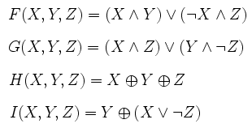
Digital Signature Algorithm (DSA)
Notes:
24
DSA differs from RSA in how the message signature is generated and validated, as shown in Stallings Figure 13.1.
RSA signatures encrypt the message hash with the private key to create a signature, which is then verified by being decrypted with the public key to compare to a recreated hash value.
DSA signatures use the message hash, global public values, private key & random k to create a 2 part signature (s,r). This is verified by computing a function of the message hash, public key, r and s, and comparing the result with r. The proof that this works is complex, but it achieves its aims!

Slide 25
DSA Key Generation
Have shared global public key values (p,q,g):
Choose q, a 160 bit
Choose a large prime p = 2^{L}
Where L= 512 to 1024 bits and is a multiple of 64
And q is a prime factor of (p-1)
Choose g = h^{(p-1)/q} mod p
Where h<p-1, h^{(p-1)/q} (mod p) > 1
Users choose private & compute public key:
Choose x<q
Compute y = g^{x} (mod p)
Notes:
25
DSA typically uses a common set of global parameters (p,q,g) for a community of clients, as shown. Then each DSA uses chooses a random private key x, and computes their public key as shown. The calculation of the public key y given x is relatively straightforward. However, given the public key y, it is computationally infeasible to determine x, which is the discrete logarithm of y to base g, mod p.

Slide 26
DSA Signature Creation
To sign a message M the sender:
Generates a random signature key k, k<q
Nb. K must be random, be destroyed after use, and never be reused
Then computes signature pair:
R = (g^{k}(mod p))(mod q)
S = (k⁻¹(h(m)+ x.R))(mod q)
Sends signature (r,s) with message M
Notes:
26
To create a signature, a user calculates two quantities, r and s, that are functions of the public key components (p,q,g), the user’s private key (x), the hash code of the message H(M), and an additional integer k that should be generated randomly or pseudo-randomly and be unique for each signing. This is similar to ElGamal signatures, with the use of a per message temporary signature key k, but doing calculations first mod p, then mod q to reduce the size of the result. The signature (r,s) is then sent with the message to the recipient. Note that computing r only involves calculation mod p and does not depend on message, hence can be done in advance. Similarly with randomly choosing k’s and computing their inverses.

Slide 27
DSA Signature Verification
Having received M & signature (r,s)
To verify a signature, recipient computes:
w = s⁻¹(mod q)
u1= (H(M).w)(mod q)
u2= (r.w)(mod q)
V = (g^{u1}.y^{u2}(mod p)) (mod q)
If v=r then signature is verified
Notes:
27
At the receiving end, verification is performed using the formulas shown. The receiver generates a quantity v that is a function of the public key components, the sender’s public key, and the hash of the incoming message. If this quantity matches the r component of the signature, then the signature is validated. Note that the difficulty of computing discrete logs is why it is infeasible for an opponent to recover k from r, or x from s. Note also that nearly all the calculations are mod q, and hence are much faster save for the last step.
The structure of this function is such that the receiver can recover r using the incoming message and signature, the public key of the user, and the global public key.I t is certainly not obvious that such a scheme would work. A proof is provided at this book’s Web site.

Slide 28
Wrapping UP
Message Digestion
MD5
SHA
Digital signatures

